Slide 1

BFX-UA300 Line Transfer Report
FOXCONN CPEG JBD_VN
2023/03/06
"Listens to customers, Meet customer expectation"

Slide 2
List Item Verification
Line Transfer Item Verification
No. | Item | Owner | Result
1 | Layout change | PM/AN | PASS
2 | ESD Management | IPQC/Tony | PASS
3 | Test Machine CPK comparision | TE/Mark | PASS
4 | Fixture test checklist | ME/Chenglun | PASS
5 | FATP & IPQC FAI | IPQC/Tony | PASS
6 | Enviroment Verification | IPQC/Tony | PASS
7 | Employee Tranning Record | PD/Wenyong | PASS
"Listens to customers, Meet customer expectation"

Slide 3
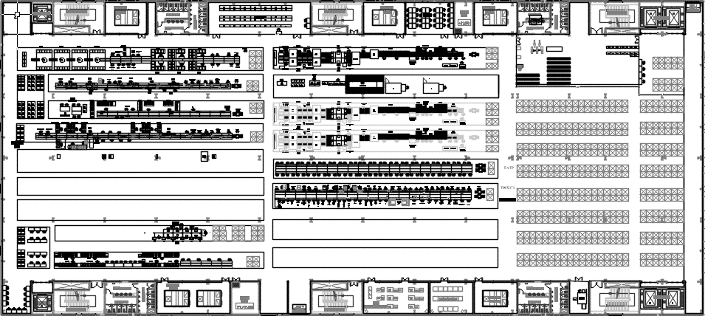
FATP Line at F07 3rdF
Other CFT FATP
Other CFT
Other CFT FATP
Other CFT
ALT FATP line
OBA
Other CFT SMT
Other CFT FATP
Summary : SMT&PTH line keep in F16

Slide 4
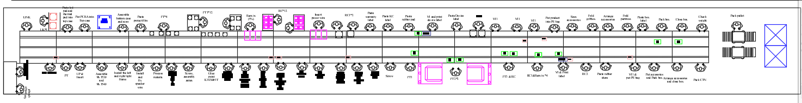
Detail FATP Line at F07 3rdF
EAGLE FATP line
SWAN FATP line
OBA
Summary : SWAN & Eagle FATP line transfer to F07 3F

Slide 5


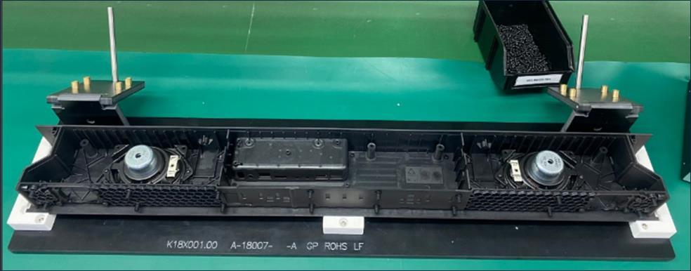
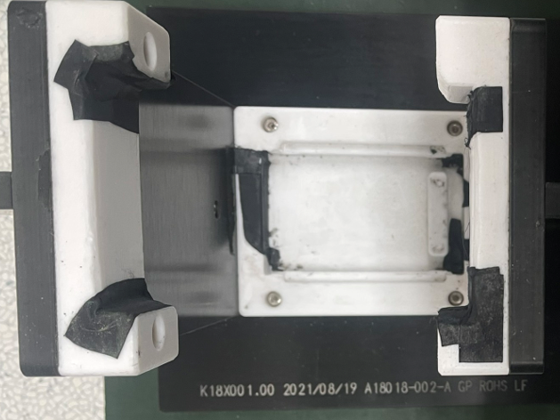
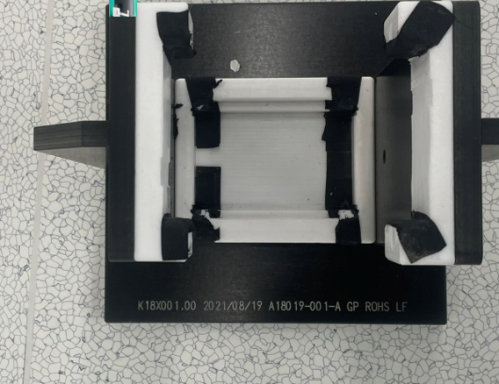
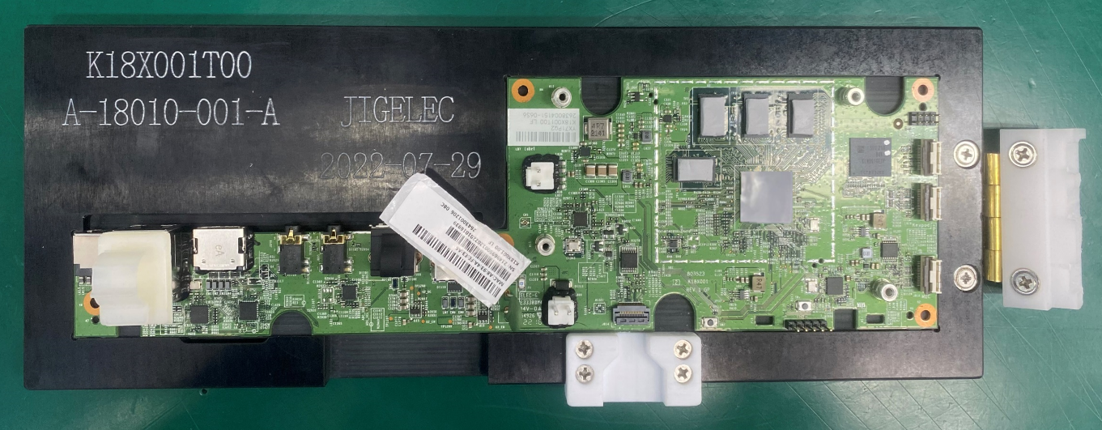
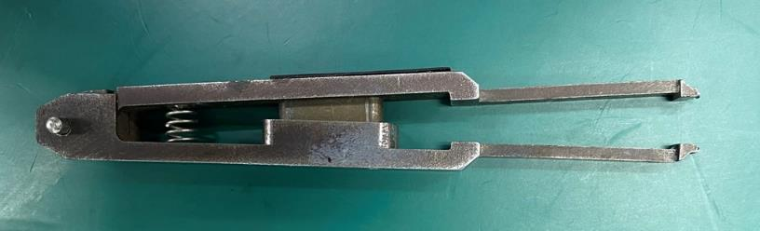
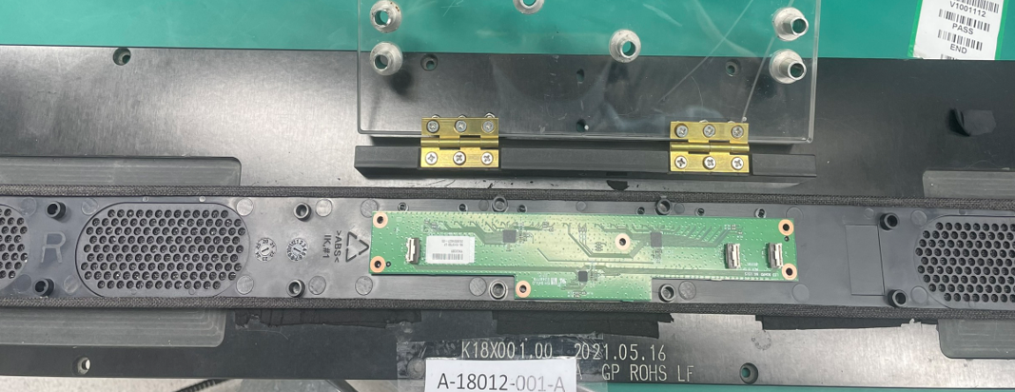
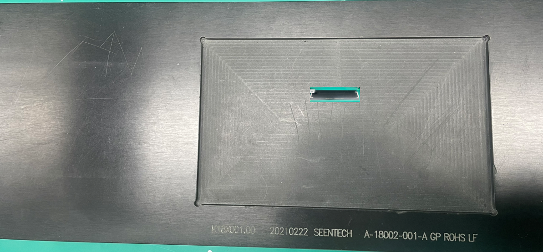
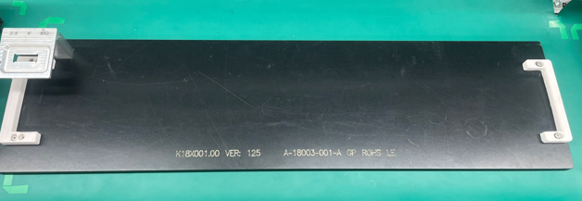
Fixture test checklist
CHECK LIST Tooling product K18X001T00
No | Station | Tool code | Image | Quality | Status
1 | Cut bavia top housing and paste thermal tape | A-18016-XXX-A |  | 1 | OK
2 | Stick sponge on top case | A-18016-XXX-A |  | 1 | OK
3 | Assembly speaker into bottom case | A-18007-XXX-A |  | 1 | OK
4 | Install the left and right light frame, fix the cable | A-18018-XXX-A |  | 2 | OK
5 | screw bottom housing | A-18019-XXX-A |  | 1 | OK
6 | Assembly heatsink& FFC cable in K18X001T00 | A-18010-XXX-A |  | 1 | OK
7 | Tool to press antenna head | A-11111-XXX-A |  | 1 | OK
8 | crew 96.1515T00 & Assembly Front Cover | A-18012-XXX-A |  | 1 | OK
9 | 1516T00&96.1517T00 and assemble Top case | A-18002-XXX-A |  | 1 | OK
10 | Assemble heatsink, paste gasket, glue point | A-18016-XXX-A |  | 1 | OK
11 | Screw | A-18016-XXX-A |  | 1 | OK
12 | Fixture tape KC | A-18003-XXX-A |  | 1 | OK
Summary : All fixture tool check no abnormal issue.
"Listens to customers, Meet customer expectation"

Slide 6
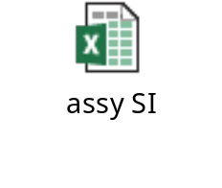





FATP & IPQC FAI
Stt | Item check | BU | Result | Record
1 | Assembly & packing SI checklist | PD | PASS
2 | Open line/change line Operation Checklist | PD | PASS
3 | Assembly & packing IPQC checklist | IPQC | PASS
4 | IPQC audit line checklist | IPQC | PASS
5 | OBA FAI Inspection | OBA | PASS
Summary : FAI & IPQC line audit check list no abnormal issue.
"Listens to customers, Meet customer expectation"

Slide 7

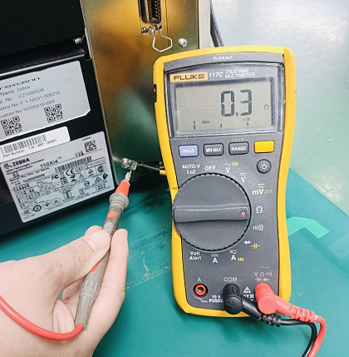

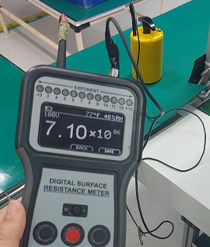
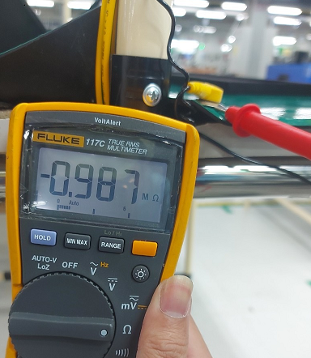
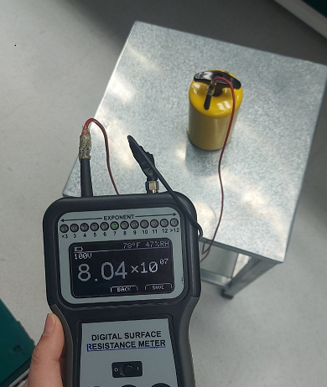

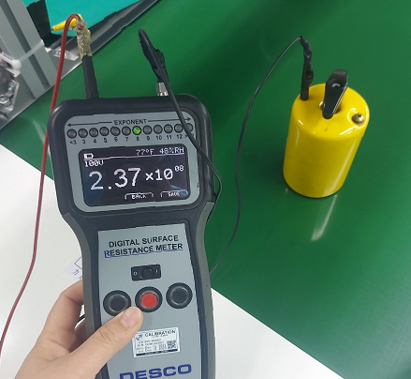

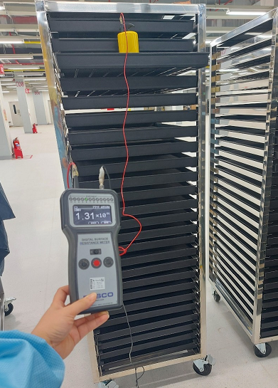

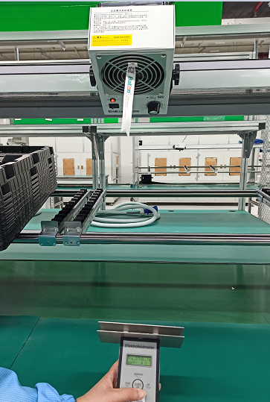

ESD Management
No. | ESD Item Check | Record | Picture | Result
1 | Machine grouding |  |  | PASS
2 | Table Surface & ESD port |  |  | PASS
3 | Chair Suface |  |  | PASS
4 | Conveyor |  |  | PASS
5 | Stack |  |  | PASS
6 | ION Fan |  |  | PASS
Summary : The ESD for new line at F07 no abnormal issue.
"Listens to customers, Meet customer expectation"

Slide 8
Test Machine CPK Comparision
F07 & F16 _All station Test Data CPK Comparison
No | Test Items | Station | F07 (A) | F16 (B) | Gap (A-B)
1 | Power 2412 | BT | 2.24 | 2.94 | -0.7
2 | Power 2434 |  | 2.71 | 2.44 | 0.27
3 | Power 2454 |  | 2.43 | 2.94 | -0.51
4 | Power 2472 |  | 2.46 | 2.9 | -0.44
5 | TX throughput | PT | 1.81 | 1.36 | 0.45
6 | RX throughput |  | 1.58 | 1.51 | 0.07
7 | Full Range Speaker_Frequency Response - 550 Hz | FT2 | 6.25 | 6.55 | -0.3
8 | Full Range Speaker_Frequency Response - 800 Hz |  | 3.83 | 4.37 | -0.54
9 | Full Range Speaker_Frequency Response - 1k Hz |  | 7.37 | 7.41 | -0.04
10 | Full Range Speaker_Frequency Response - 4k Hz |  | 4.91 | 4.48 | 0.43
11 | Full Range Speaker_Frequency Response - 10k Hz |  | 2.02 | 1.99 | 0.03
12 | Full Range Speaker_THD - 1k Hz |  | 3.42 | 3.78 | -0.36
13 | Full Range Speaker_Balance_Left - 1k Hz |  | 5.44 | 6.75 | -1.31
14 | Full Range Speaker_Balance_Right - 1k Hz |  | 3.11 | 3.87 | -0.76
15 | Full Range Speaker_Left to Right Radio |  | 7.77 | 8.08 | -0.31
16 | Woofer Speaker_Frequency Response - 100 Hz |  | 7.61 | 6.75 | 0.86
17 | Woofer Speaker_Frequency Response - 400 Hz |  | 9.7 | 10.18 | -0.48
18 | Woofer Speaker_Frequency Response - 550 Hz |  | 7.22 | 7.9 | -0.68
19 | Woofer Speaker_THD - 400 Hz |  | 1.77 | 2.18 | -0.41
20 | Woofer Speaker_Balance_Left - 400 Hz |  | 16.65 | 18.26 | -1.61
21 | Woofer Speaker_Balance_Right - 400 Hz |  | 7.69 | 7.81 | -0.12
22 | Woofer Speaker_Left to Right Radio |  | 13.86 | 15.72 | -1.86
23 | Woofer Speaker_Air Leakage Test_Pushing - 850 Hz |  | 1.57 | 1.56 | 0.01
24 | Mic1_Sensitivity - 1k Hz |  | 8.37 | 9.03 | -0.66
25 | Mic2_Sensitivity - 1k Hz |  | 4.32 | 3.32 | 1
26 | Mic3_Sensitivity - 1k Hz |  | 5.25 | 3.71 | 1.54
27 | Mic4_Sensitivity - 1k Hz |  | 9.24 | 9.99 | -0.75
28 | Mic1_Isolation - 1k Hz |  | 7.73 | 8.36 | -0.63
29 | Mic2_Isolation - 1k Hz |  | 13.36 | 18.31 | -4.95
30 | Mic3_Isolation - 1k Hz |  | 13.07 | 12.76 | 0.31
31 | Mic4_Isolation - 1k Hz |  | 5.45 | 4.12 | 1.33
32 | RSSI | FT3 | 2.54 | 2.31 | 0.23

Slide 9

Test Machine CPK Comparision
FATP SWAN Test Data Detail Information
Model | Description | MO | Location | Quantity | Test time | Result
 |  |  |  | (pcs)
BFX-UA300 | Set Top Box | 2639004274 | F16 | 100 | 2022/08/29 | PASS
BFX-UA300 | Set Top Box | 2643002655 | F07 | 70 | 2023/03/01 | PASS
Summary:
All test result of CPK data (F16) were got higher 1.33, the process is capable & meet specification
The CPK’s gap between F16 and F07 is quite closed, not too large.
Not found any abnormal of BFX-UA300 test environment when tested at F07’s factory.

Slide 10
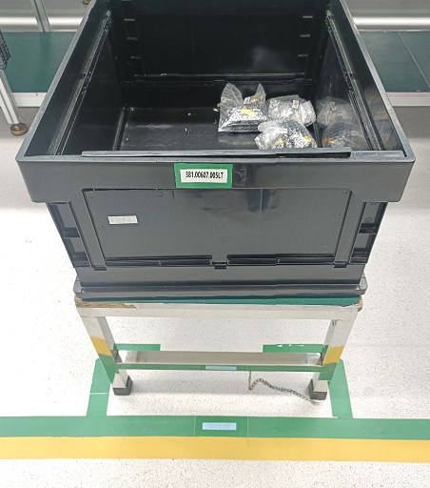
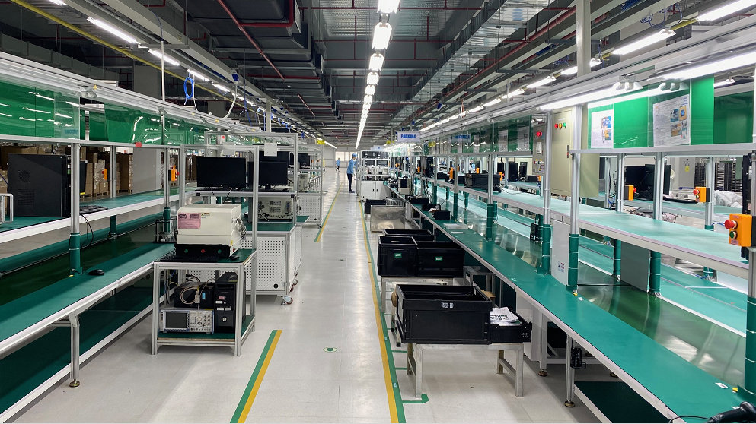
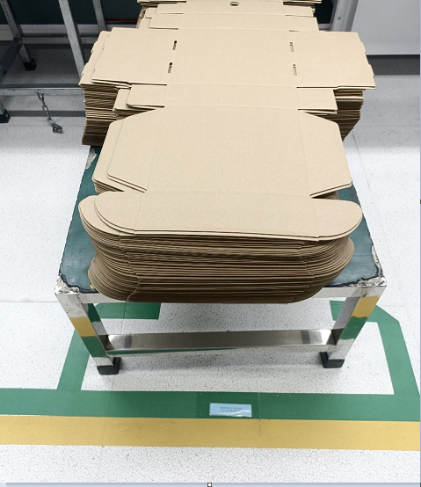
5S Environment
Summary : New lines with good environment, Placement areas were remarked clearly
"Listens to customers, Meet customer expectation"

Slide 11

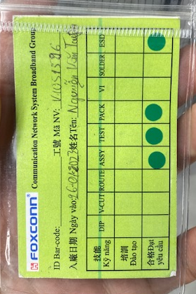
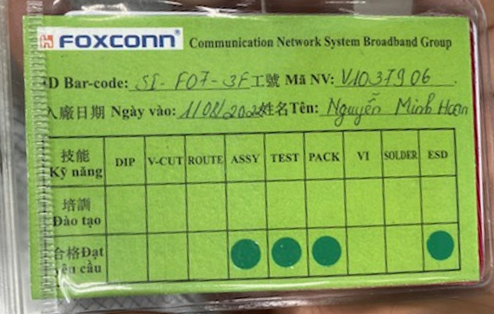
Manpower Training Record
K18X001.00 排站表
序號 STT | 站位 Công đoạn | 工號 Mã thẻ | 姓名 Họ tên | 輪休 Luân phiên | 入廠日期 Ngày vào | 上崗時間 Ngày đào tạo | Remark
1 | Paste mylar into FFC cable and cut bavia in top cover Dán băng dính tản nhiệt vào dây FFC và gọt bavia | V0976880 | Đặng Thị Thi | T3 | 10/18/2019 | 28.02.2023 | PASS
2 | Stick sponge on top case Dán đệm xốp vỏ trên | V1015475 | Luận Thị Thảo | T7 | 2021/09/10 | 28.02.2023 | PASS
3 | LINK&AMP | V1046202 | Hoàng Thị Áo | CN | 2022/09/20 | 28.02.2023 | PASS
4 | BT | V1051625 | Đặng Văn Tình | T2 | 1/26/2023 | 28.02.2023 | PASS
5 | PT | V1046214 | Lương Thị Giang | T6 | 2022/09/20 | 28.02.2023 | PASS
6 | UP +Insert power wire 1 | V1051596 | Nguyễn Văn Tuyền | T7 | 1/26/2023 | 28.02.2023 | PASS
7 | Assembly speaker into bottom case Lắp loa vào vỏ dưới. | V1016676 | Chu Thị Hiền | T4 | 2021/10/02 | 28.02.2023 | PASS
8 | Assemble FFC Cable, glue point and insert light bracket Lắp dây cáp, điểm keo và lắp gá đèn trái phải | V1022494 | Nông Văn Lan | T7 | 2022/02/12 | 28.02.2023 | PASS
9 | Assemble 96.1540T00&96.1520T00 board into bottom housing. Lắp 96.1540T00 và 96.1520T00 vào nắp dưới | V1037906 | Nguyễn Minh Hoan | T6 | 1999/08/18 | 28.02.2023 | PASS
10 | Install the left and right light frame, fix the cable Lắp khung đèn trái, phải & Dán cố định dây cap | V1051415 | Lê Văn Duẩn | T4 | 1/26/2023 | 28.02.2023 | PASS
11 | Processing material Gia công liệu | V1013434 | Vi Thị Cần | T6 | 2021/08/06 | 28.02.2023 | PASS
12 | Install and fix speaker wire Lắp và dán cố định dây loa | V1053091 | Phạm Thị Loan | T3 | 2023/02/14 | 28.02.2023 | PASS
13 | Assembly heatsink& FFC cable in K18X001T00 Lắp tản nhiệt, dây FFC cable vào bản K18X001T00 | V1052311 | Lương Văn Quang | T7 | 2023/01/13 | 28.02.2023 | PASS
14 | Screw, assembly anten and 2 wrie saddle Vít ốc, lắp anten và 2 chốt dây | V0941929 | Cứ A Trợ | T6 | 2/1/1986 | 28.02.2023 | PASS
Summary : All OP passed training and have certificate working card.
"Listens to customers, Meet customer expectation"

Slide 12
Line Transfer Summary
Summary :
The ESD for new line at F07 no abnormal issue.
All test result of CPK data (F07) were got higher 1.33, the process is capable & meet specification
Not found any abnormal of test environment when tested at F07’s factory.
New lines with good environment, the placement areas were remarked clearly.
All OP passed training and have certificate working card.
FAI & IPQC line audit check list no abnormal issue.
All fixture tool check no abnormal issue.
Conclusion : We can start Mass Production BFX-UA300 at F07 factory.
"Listens to customers, Meet customer expectation"

